Slide 1
C# Basic
Owner | 1Rivet – TECH
Classification | LOW
Type | GENERAL
Access Permission | 1R - INDIA

Slide 2
AGENDA
Introduction
Overview of .Net Framework
C# Programming Language
Basic Structure of C# Program
Methods and Properties
Data Types, Literals, Type Casting , Variables and Operators
Control Flow
Loop
While Loop
Do While Loop
For Loop
Jump Statements
Functions
String and String Builder
Static, Const & Read-Only
Stack and Heap
Boxing & UnBoxing

Slide 3
01
Introduction

Slide 4
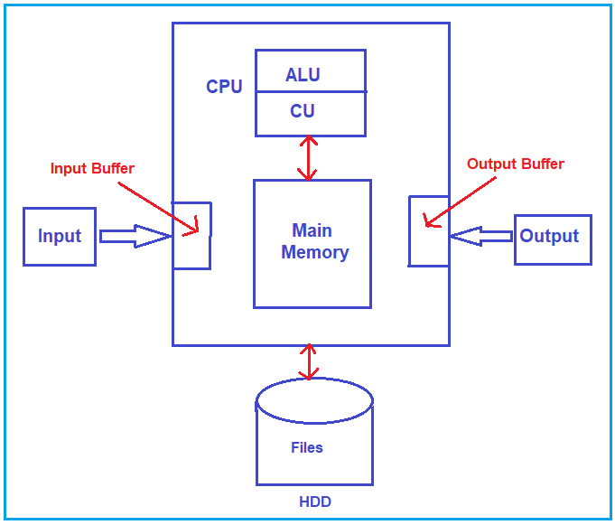
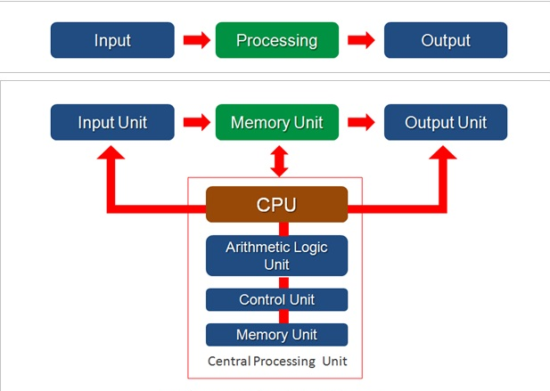

C#.Net Basics
How Computer works ?
What is computer?

Slide 5
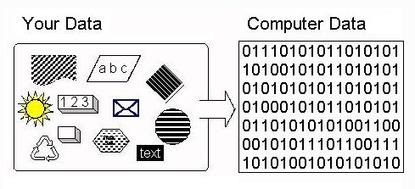
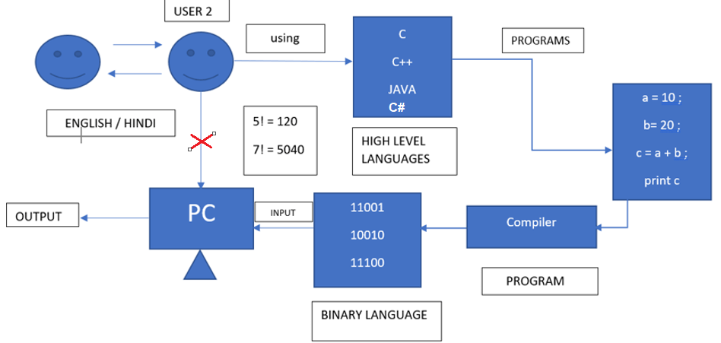
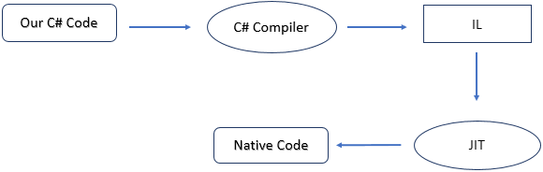
Continue…
Programming Language ?

Slide 6
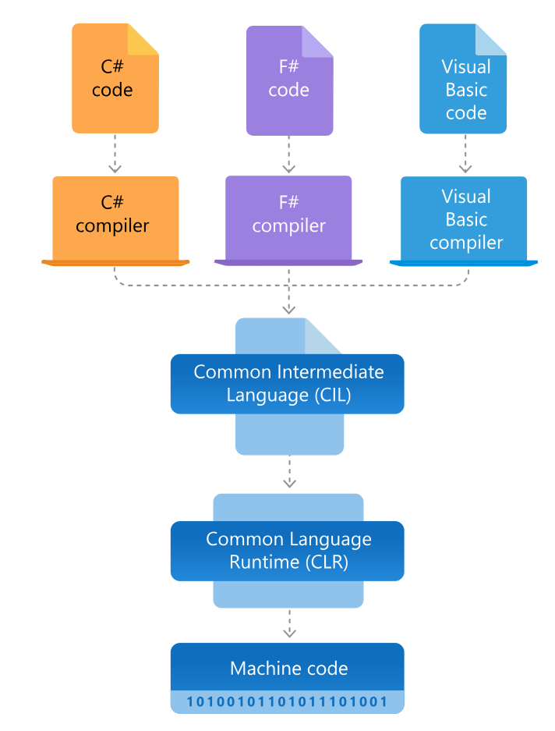
Overview of .Net Framework
.

Slide 7
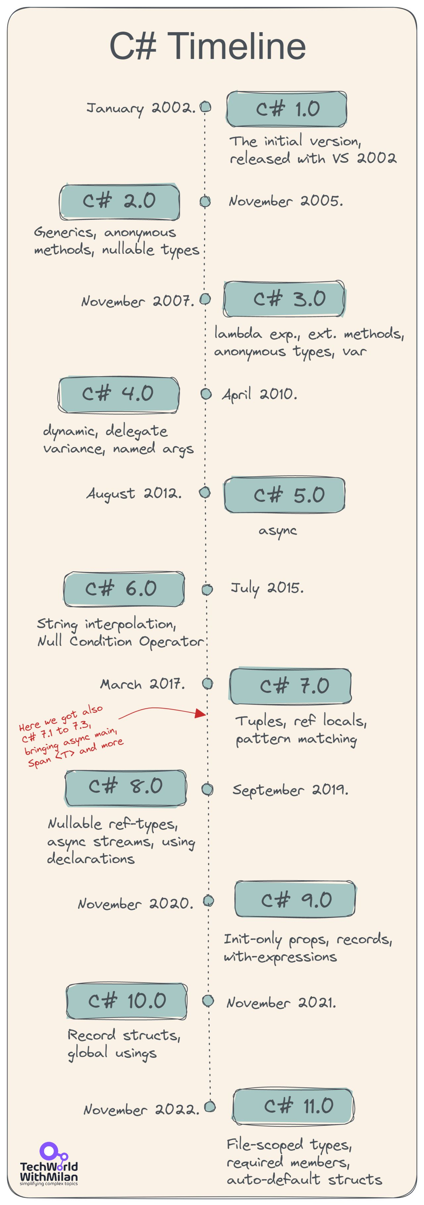
C# Programming language
Designed to overcome disadvantages of C and C++
Why C# is popular ?

Slide 8
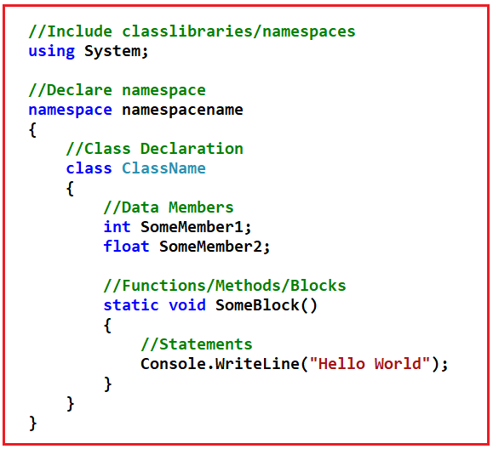
Basic Structure of C# program
Namespace
Class
Members
Block/Methods/Functions
Statements

Slide 9
02
Method and Properties

Slide 10
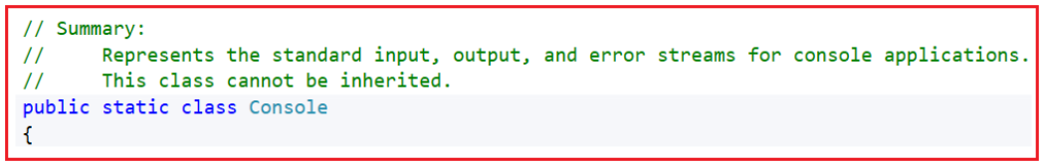
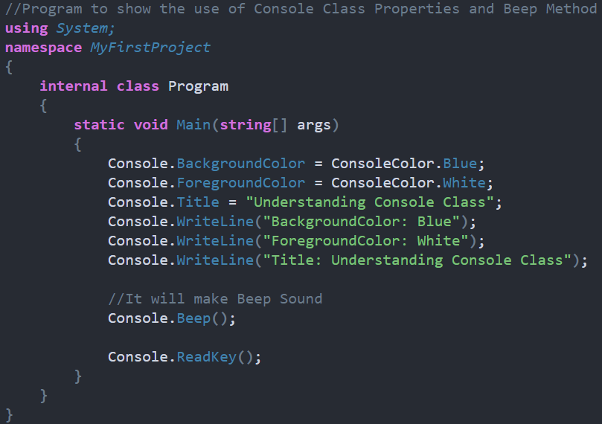
Methods & properties of console class
Console Class -
Properties in C# Console class
Method in C# Console Class

Slide 11
Properties
Used to set and get data from data field of a class.
Medium or interface to transfer data and it doesn’t store any data in it.
Accessors:- Special methods used to set or get values from underlying data member of a class
Setter – set data into a data field, contains fixed variable name value
Syntax: set { Data_Field_Name = value; }
Getter – get the data from data field.
Syntax: get {return Data_Field_Name;}
Symmetric Accessors – specifier of accessors are same as property accessibility specifier
Syntax: public int EmpId { protected set { _EmpId = value; } get { return _EmpId; } }
Asymmetric accessors – specifier of accessor are not same as property accessibility specifier
Syntax: public int EmpId { private set { _EmpId = value; } get { return _EmpId; } }

Slide 12
03
DataType, Literals, TypeCasting Variables, Operators

Slide 13
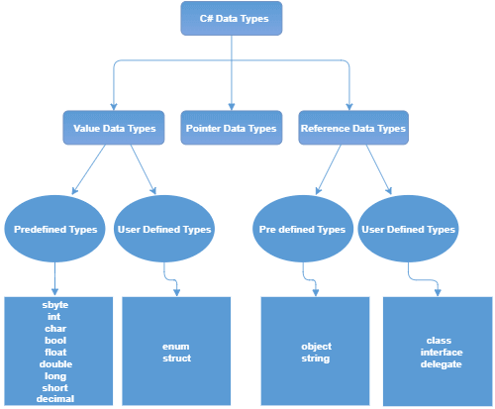
Data Types

Slide 14
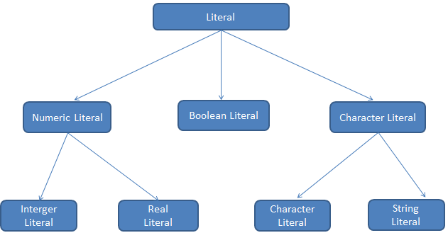
Literals
Fixed values or hard coded values assigned to variable and cannot be modified during execution
For example, int x = 100; Here x is a variable, and 100 is literal.

Slide 15
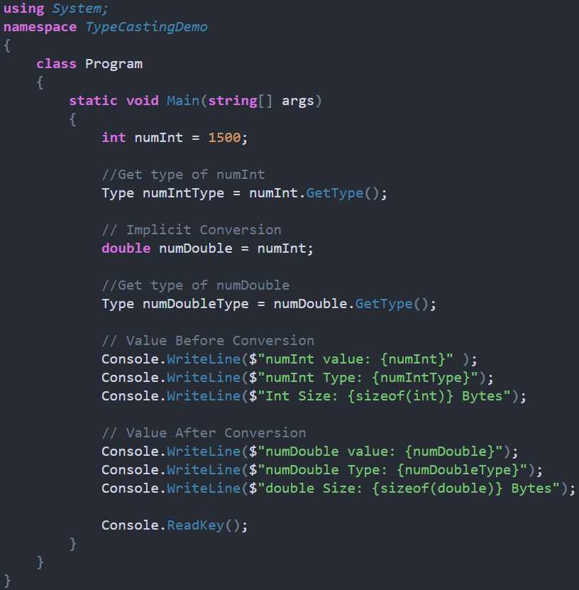
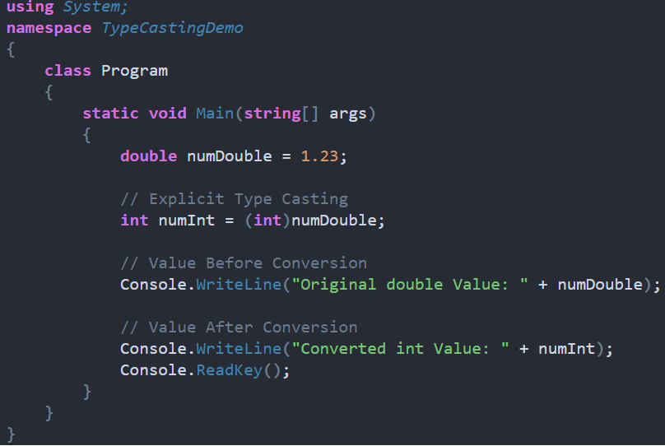
Type Casting
Implicit Type Casting
Done by compiler itself.
Conversion is done from smaller to larger types
No data loss
Explicit Type Casting
Done by using Cast operator
Conversion done from larger to smaller type
Data can be loss

Slide 16
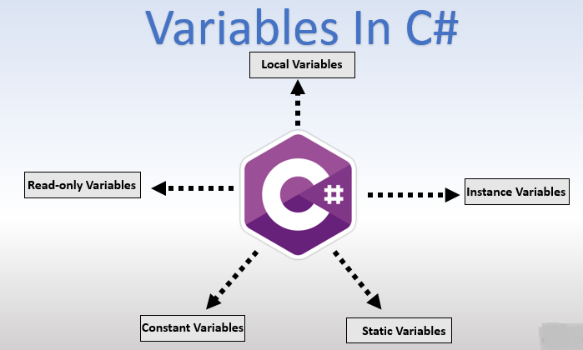
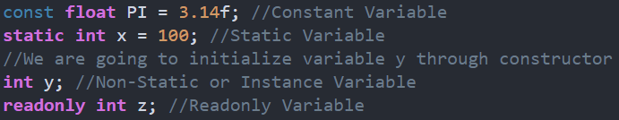
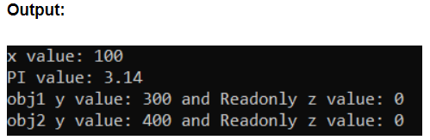
Variables

Slide 17
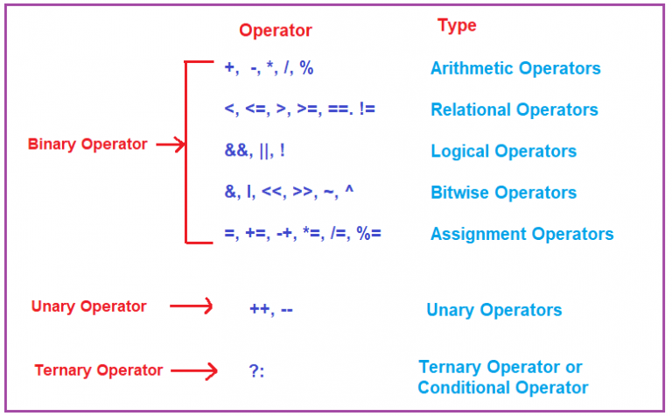
Operators
Symbols used to perform operations on operands

Slide 18
04
Control Flow

Slide 19
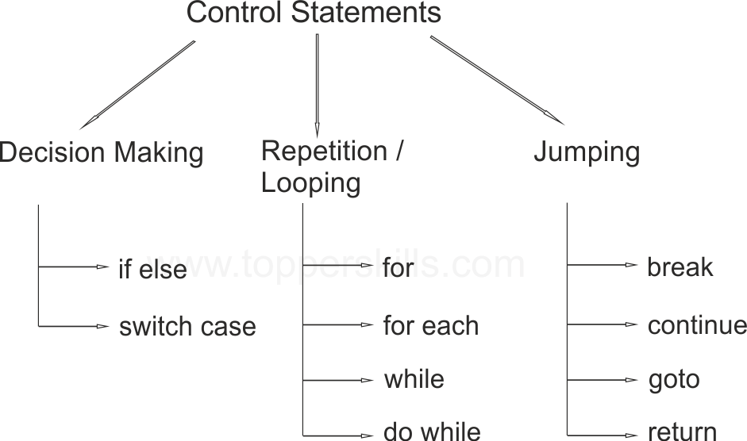
Control flow

Slide 20
05
Loops

Slide 21

Loops
Facilitates the execution of a set of instructions repeatedly while some conditions evaluated to true.
Purpose of loop is code repetition.
Loops
Counter
Conditional
Counter :- Executes a specific set of instructions a certain number of times
Conditional :- Executes a specific task until condition is true.

Slide 22
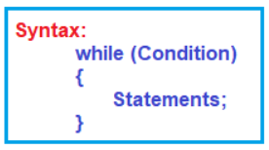
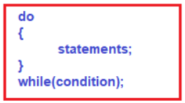
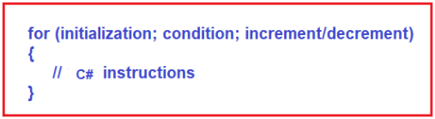
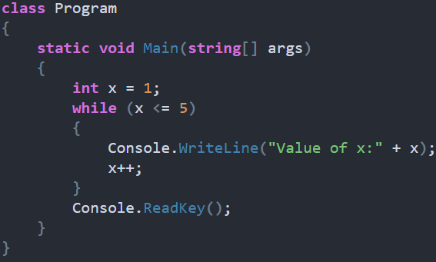
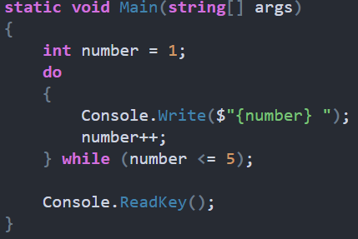
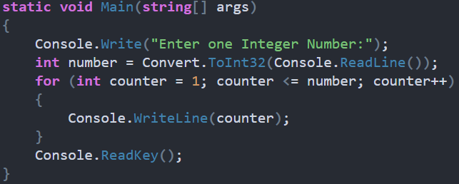
Continue…
While Loop
Do While Loop
For Loop

Slide 23
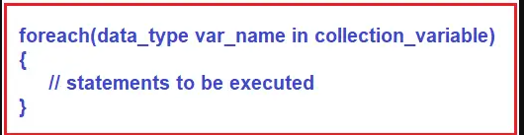
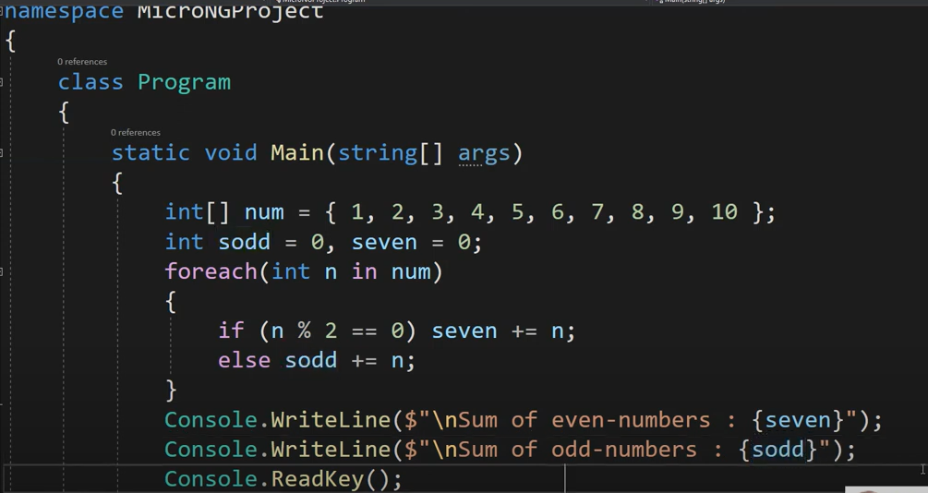
Continue…
Foreach Loop

Slide 24
06
Jump Statements

Slide 25
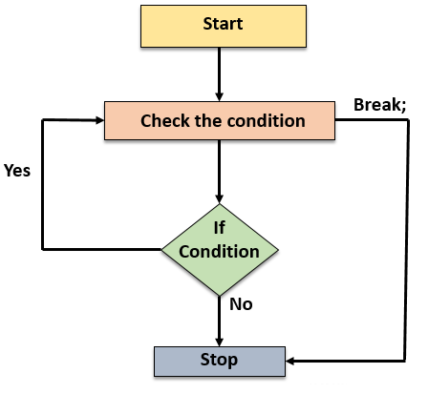
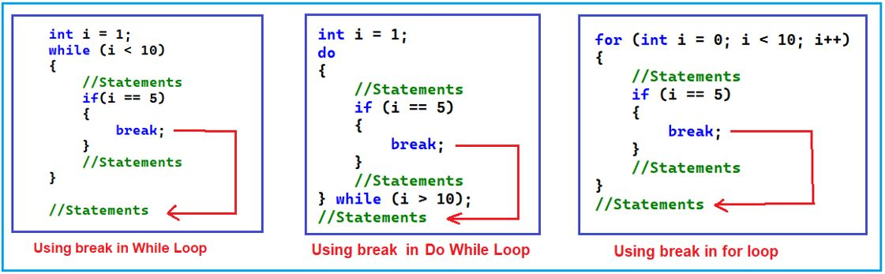
Break Statement
Example:

Slide 26
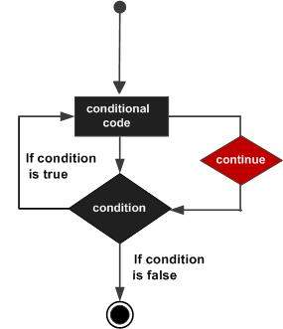
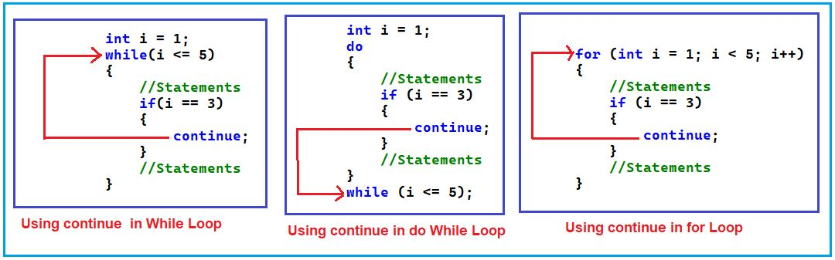
Continue Statement
Example:

Slide 27
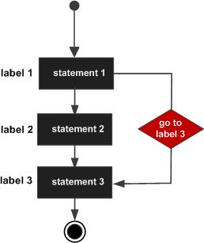
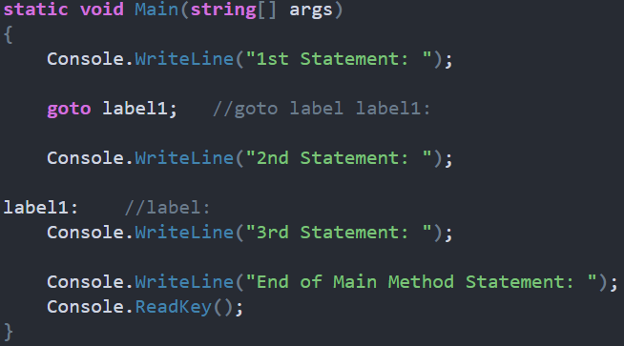
Go To Statement
Example:

Slide 28
07
Functions

Slide 29
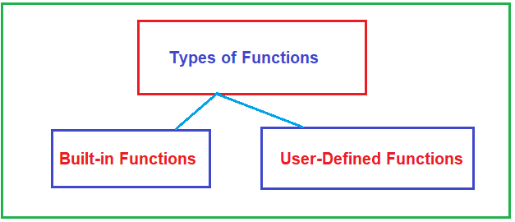
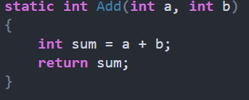
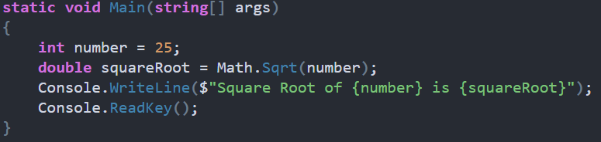
Functions
User-Defined
What is user-define function ?
Example:
Built-in Functions
What is Built-In functions
Example:

Slide 30
08
String and String Builder

Slide 31
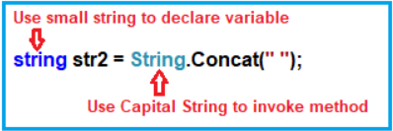

String
Reference Type – String data type references class and class is reference type
String(Capital) vs string(small) - Small string is alias of big String
Strings are Immutable ?

Slide 32
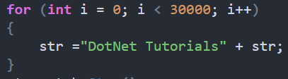
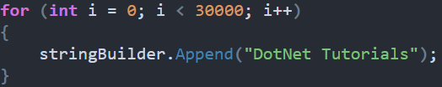


String Builder
What is String Builder ?
Why and When we have to use it ?
Example

Slide 33
09
Static, Cont and Read-Only

Slide 34
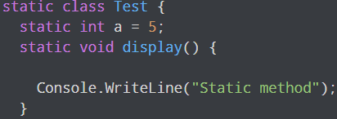
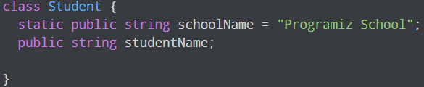
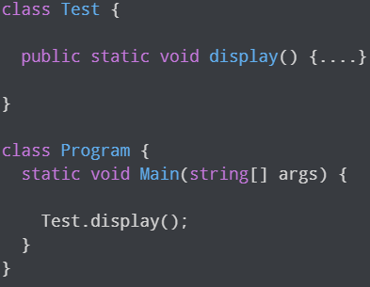

Static Keyword
What is static ? How we use static Keyword in C# ?
Static Class
Static Variables
Static Methods
Static Constructor

Slide 35
Const & Read-only
Constants
Variable value never going to changed or modified once after its declaration.
Static by default
Behavior same as static variable, maintains only one copy in lifecycle of class and initializes immediately once execution of class start.
Example:
const float PI = 3.14f;
Read-only
Variable initialization is not mandatory, and value of variable can be changed from constructor.
Non-Static by default
Behavior same as non-static variable, maintain a separate copy of each object.

Slide 36
10
Stack and Heap

Slide 37
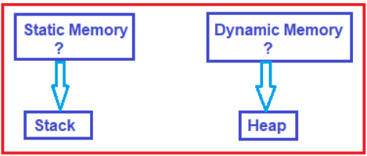
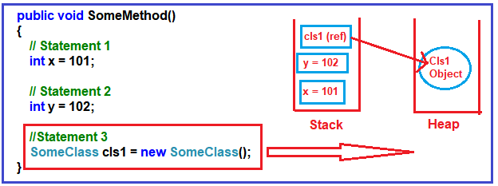
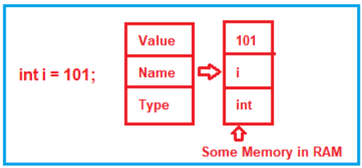
Stack & Heap
Types of Memory
What is Stack and Heap ?

Slide 38
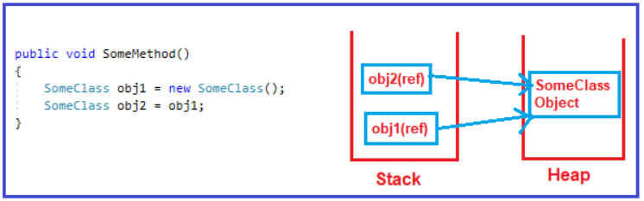
Stack & Heap
Value types
Reference types
Deallocation of memory

Slide 39
11
Boxing and Un-Boxing

Slide 40
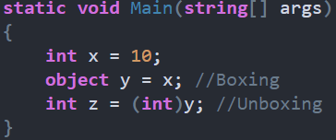
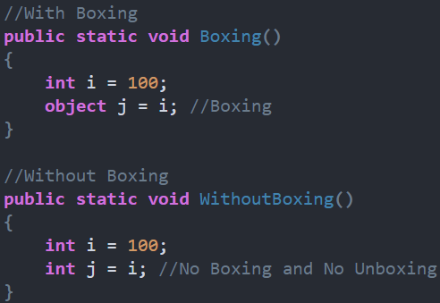

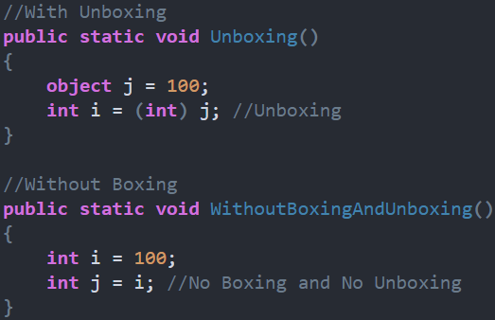
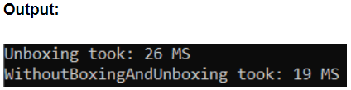
Boxing & Unboxing
What is Boxing and Unboxing ?
Performance implication of Boxing
Performance implication of UnBoxing

Slide 41
Reference link
C#.NET Tutorials For Beginners - Dot Net Tutorials
Learn C# Tutorial (C Sharp) (geeksforgeeks.org)

